Slide 1

Shadow strike
Mobile Computing Event-02
Vadiraj Hayagreeva Krishnakumar Balachandra Bhat Gururaj Deepak Todurkar B R Manoj

Slide 2


Introduction
Welcome to our presentation on an immersive and engaging game experience. Explore the captivating world of player movement, jumping mechanics, and score tracking.

Slide 3

Player Movement
Smooth, responsive movements allow players to navigate seamlessly
Intuitive controls enable players to quickly adapt and explore
Precise control over speed and direction enhances player agency

Slide 4

Jumping Mechanics
Jump height and duration controlled by button press duration
Precise timing and coordination required to clear gaps and obstacles
Responsive, smooth jump animations for immersive player experience

Slide 5

Fragile Platforms
Precarious platforms disintegrate rapidly, requiring players to react quickly and jump to safety.

Slide 6



Collect the Gold Points
Gather the Coins
Time Your Jumps
Earn High Scores
Collect the valuable gold points scattered throughout the level.
Time your jumps precisely to grab the coins before they disappear.
Collect as many coins as possible to achieve the highest scores.

Slide 7

High Score Tracking
Score Milestones
Persistent Scores
Achieve new high score thresholds for rewards
Player's high scores saved across sessions
1
2
3
Leaderboard Display
Real-time global leaderboard with top players

Slide 8



Music Integration
Ambient Soundtrack
Dynamic Audio Cues
Customizable Audio
Immersive background music sets the tone.
Responsive sound effects for key events.
Allow players to adjust music and sound levels.

Slide 9
Additional Features
Accessibility Options
Challenge Modes
Collectible Items
Discover power-ups, upgrades, and hidden treasures to enhance play.
Customizable controls and visual settings for diverse player needs.
Unlock and explore different difficulty settings to test skills.

Slide 10
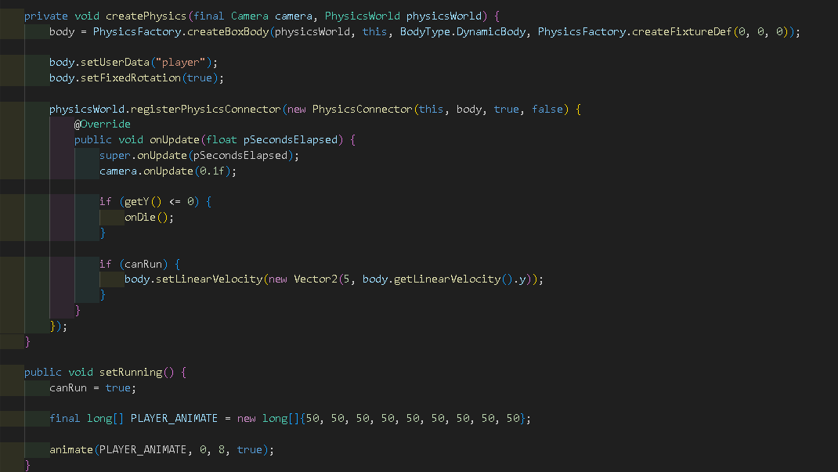
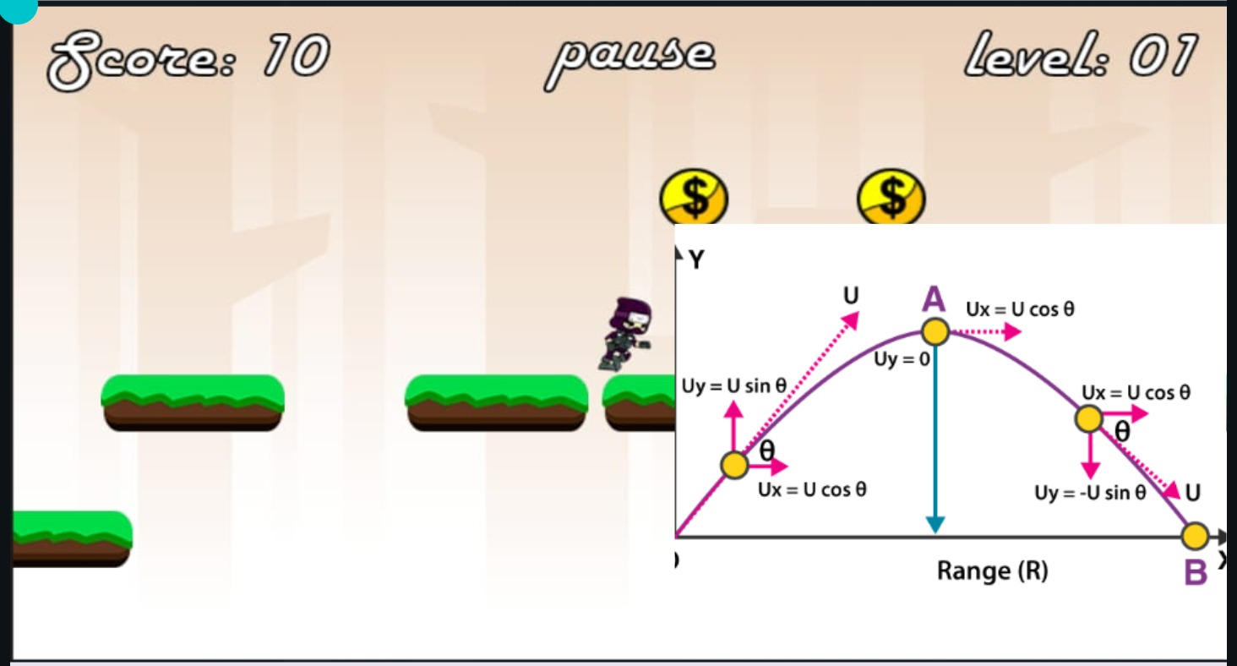
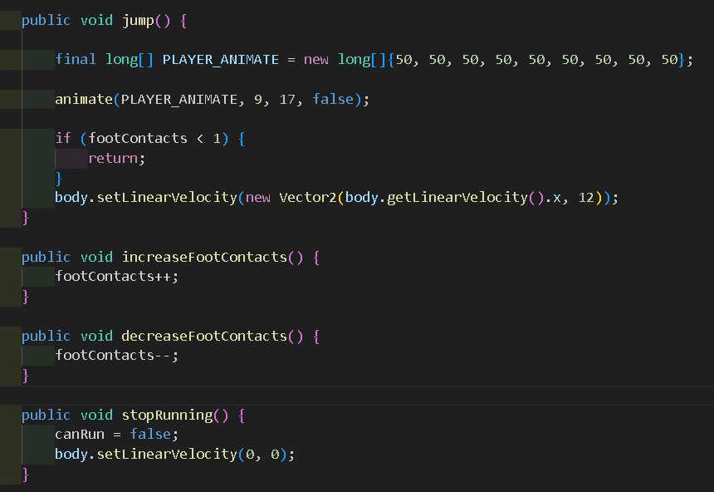
code Logic

Slide 11
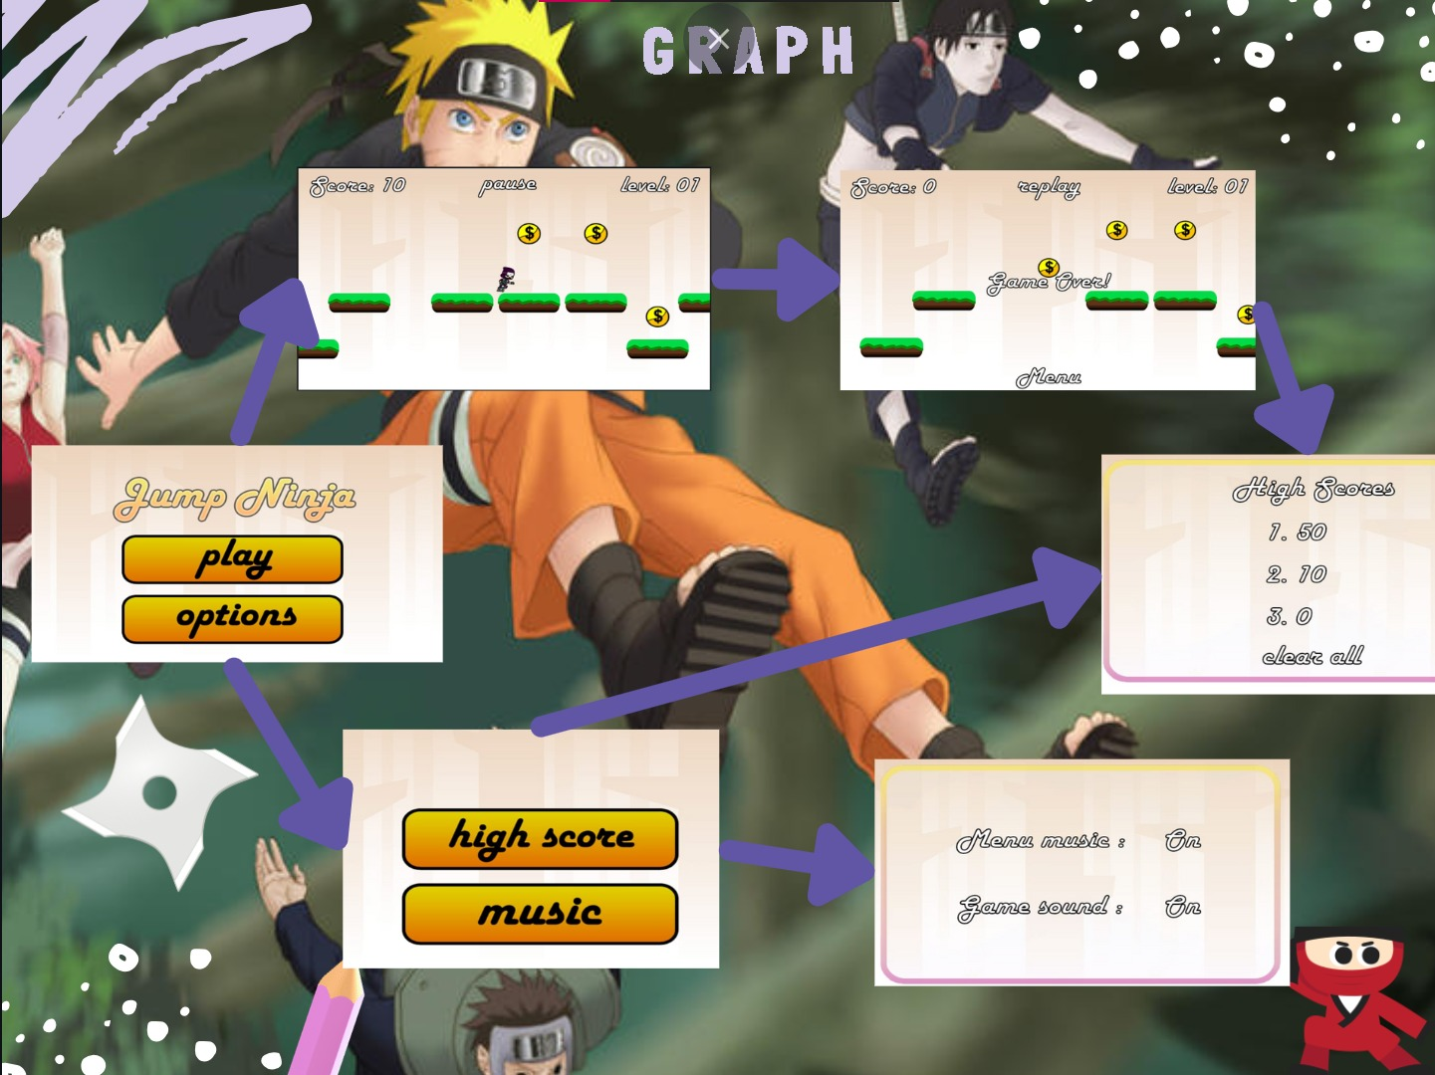

Slide 12

Conclusion
A final summary highlighting the key features and benefits of the game, inspiring players to dive in and explore the engaging world.

